Slide 1
Spring Boot Introduction

Slide 2
You will learn how to …
Quickly develop Spring Boot applications
Develop a REST API using Spring Boot
Create a Spring MVC app with Spring Boot
Connect Spring Boot apps to a Database for CRUD development
Leverage all Java configuration (no xml) and Maven

Slide 3
Practical Results
Introduction to Spring Boot development
•
Not an A to Z reference
•
For complete reference, see Spring Boot Reference Manual
https://spring.io/projects/spring-boot

Slide 4





The Problem
Building a Spring application is really HARD!!!
Q: What Maven archetype to use?
And that's JUST the basics
for getting started
Q: Which Maven dependencies do I need?
Q: How do I set up configuration (xml or Java)?
Q: How do I install the server? (Tomcat, JBoss etc…)

Slide 5

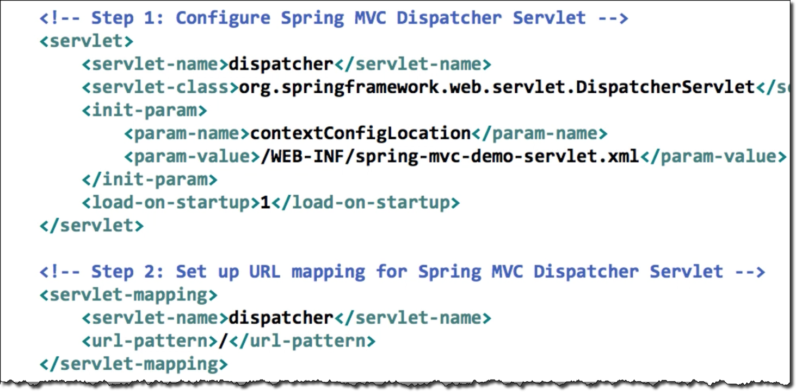
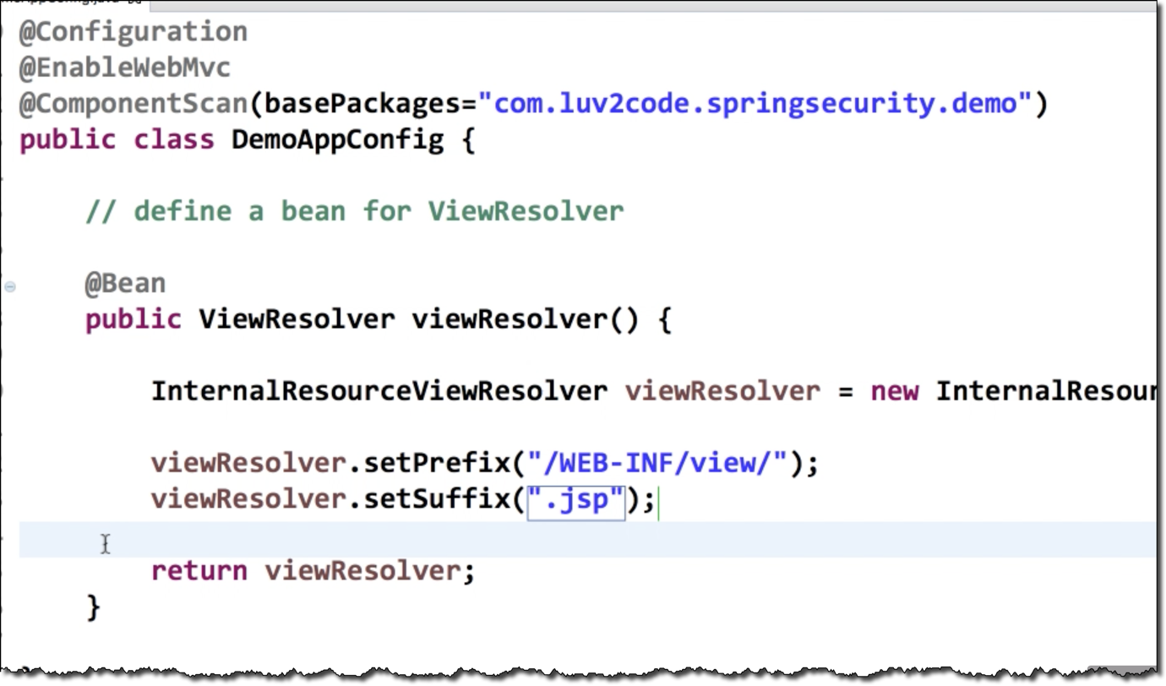
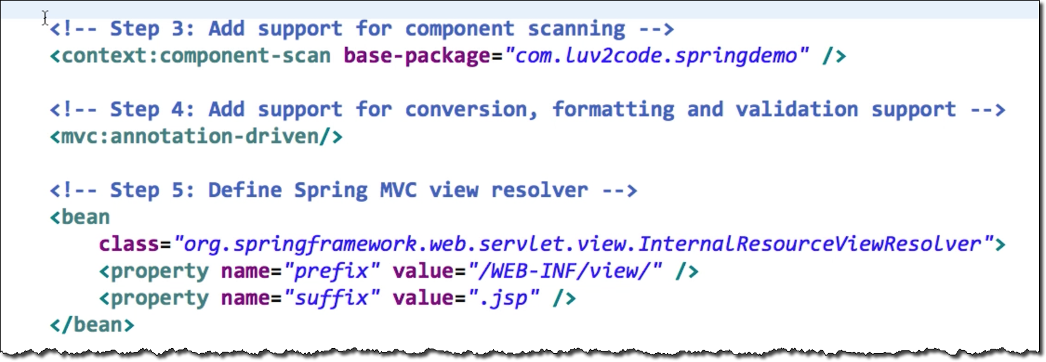
The Problem
Very error-prone
Easy to make a simple mistake
Tons of configuration

Slide 6

The Problem
Very error-prone
Easy to make a simple mistake
Tons of configuration
There should be an easier solution

Slide 7

Spring Boot Solution
Make it easier to get started with Spring development
Minimize the amount of manual configuration
Perform auto-configuration based on props files and JAR classpath
Help to resolve dependency conflicts (Maven or Gradle)
Provide an embedded HTTP server so you can get started quickly
Tomcat, Jetty, Undertow, …

Slide 8
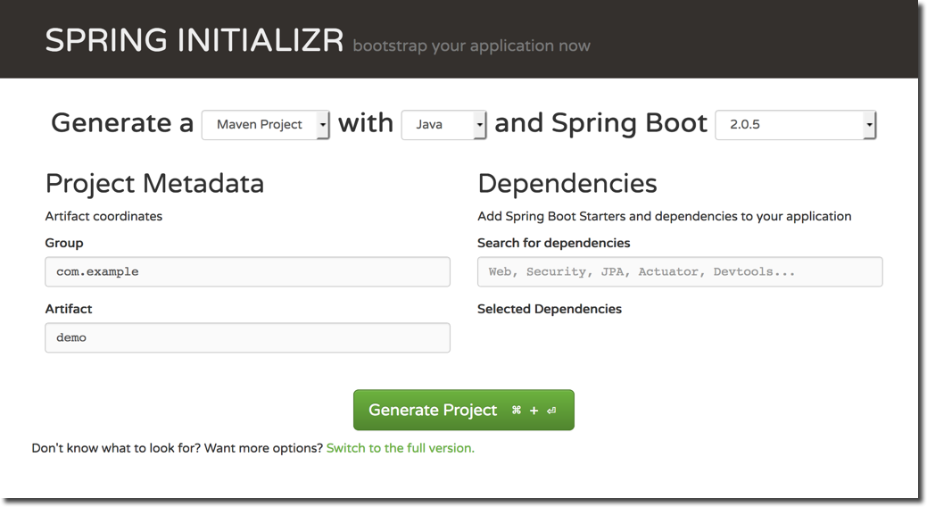
Spring Initializr
•
Quickly create a starter Spring project
http://start.spring.io
•
Select your dependencies
•
Creates a Maven/Gradle project
•
Import the project into your IDE
•
Eclipse, IntelliJ, NetBeans etc …

Slide 9


Spring Boot Embedded Server
•
Provide an embedded HTTP server so you can get started quickly
Tomcat, Jetty, Undertow, …
No need to install a server separately
•
Self-contained unit Nothing else to install
mycoolapp.jar
mycode
JAR file
includes your application code AND
includes the server
Tomcat

Slide 10


Running Spring Boot Apps
Spring Boot apps can be run standalone (includes embedded server)
Run the Spring Boot app from the IDE or command-line
mycoolapp.jar
mycode
> java -jar mycoolapp.jar
Tomcat
Name of our JAR file

Slide 11
Deploying Spring Boot Apps
Spring Boot apps can also be deployed in the traditional way
Deploy WAR file to an external server: Tomcat, JBoss, WebSphere etc …
Tomcat
mycoolapp.war travel.war shopping.war
mycode

Slide 12








Spring Boot FAQ #1
Q: Does Spring Boot replace Spring MVC, Spring REST etc …?
No. Instead, Spring Boot actually uses those technologies
Once you do Spring Boot configs then you make use of regular Spring coding
Spring Boot
Spring MVC
Spring REST
Spring …
@Component @Controller @Autowired etc…
Spring Core
Spring AOP
Spring …

Slide 13

Spring Boot FAQ #2
Q: Does Spring Boot run code faster than regular Spring code?
No.
Behind the scenes, Spring Boot uses same code of Spring Framework
Remember, Spring Boot is about making it easier to get started
Minimizing configuration etc …

Slide 14


Spring Boot FAQ #3
Q: Do I need a special IDE for Spring Boot?
No.
You can use any IDE for Spring Boot apps … even use plain text editor
The Spring team provides free Spring Tool Suite (STS) [IDE plugins]
Some IDEs provide fancy Spring tooling support
Not a requirement. Feel free to use the IDE that works best for you

Slide 15
Spring Boot Initializr Demo

Slide 16
Spring Initializr
•
Quickly create a starter Spring project
http://start.spring.io
•
Select your dependencies
•
Creates a Maven/Gradle project
•
Import the project into your IDE
•
Eclipse, IntelliJ, NetBeans etc …

Slide 17
Development Process
Step-By-Step
1. Configure our project at Spring Initializr website
Download the zip file
Unzip the file
Import Maven project into our IDE
http://start.spring.io

Slide 18
Spring Boot - Create REST Controller

Slide 19
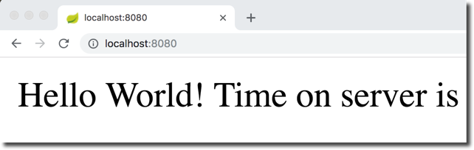
REST Controller
Let's create a very simple REST Controller

Slide 20


Create REST Controller
@RestController
public class FunRestController {
// expose "/" that return "Hello World" @GetMapping("/")
public String sayHello() {
return "Hello World! Time on server is " + LocalDateTime.now();
}
Current time stamp

Slide 21
Spring Boot Project Structure

Slide 22

Spring Initializr
Spring Initializr created a Maven project for us
http://start.spring.io
Let's explore the project structure

Slide 23

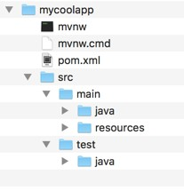




Maven Standard Directory Structure
Directory | Description
src/main/java | Your Java source code
src/main/resources | Properties / config files used by your app
src/test/java | Unit testing source code

Slide 24




Maven POM file
pom.xml includes info that you entered at Spring Initializr website
<groupId>com.luv2code.springboot.demo</groupId>
<a
rtifactId>mycoolapp</artifactId>
ersion>0.0.1-SNAPSHOT</version> ackaging>jar</packaging>
<v
<p
<dependencies>
<dependency>
<groupId>org.springframework.boot</groupId>
<artifactId>spring-boot-starter-web</artifactId>
</dependency>
<dependency>
<groupId>org.springframework.boot</groupId>
<artifactId>spring-boot-starter-test</artifactId>
<scope>test</scope>
</dependency>
…
</dependencies>

Slide 25

Maven POM file
Spring Boot Starters
•
pom.xml includes info that you entered at^{A}S^{c}pºr^{ll}i^{e}n^{c}g^{tio}I^{n}nºit^{f}i^{M}alªi^{v}z^{e}r^{n}w^{de}e^{p}b^{e}s^{n}i^{d}t^{e}e^{ncies}
(Compatible versions)
<groupId>com.luv2code.springboot.demo</groupId>
<a
rtifactId>mycoolapp</artifactId>
ersion>0.0.1-SNAPSHOT</version> ackaging>jar</packaging>
<v
<p
<dependencies>
<dependency>
<groupId>org.springframework.boot</groupId>
<artifactId>spring-boot-starter-web</artifactId>
</dependency>
<dependency>
<groupId>org.springframework.boot</groupId>
<artifactId>spring-boot-starter-test</artifactId>
<scope>test</scope>
</dependency>
…
</dependencies>

Slide 26

Maven POM file
Spring Boot Starters
•
pom.xml includes info that you entered at^{A}S^{c}pºr^{ll}i^{e}n^{c}g^{tio}I^{n}nºit^{f}i^{M}alªi^{v}z^{e}r^{n}w^{de}e^{p}b^{e}s^{n}i^{d}t^{e}e^{ncies}
(Compatible versions)
<groupId>com.luv2code.springboot.demo</groupId>
<a
rtifactId>mycoolapp</artifactId>
ersion>0.0.1-SNAPSHOT</version> ackaging>jar</packaging>
<v
<p
<dependencies>
<dependency>
<groupId>org.springframework.boot</groupId>
<artifactId>spring-boot-starter-web</artifactId>
</dependency>
<dependency>
<groupId>org.springframework.boot</_{s}g_{p}r_{r}o_{in}u_{g}p₋I_{w}d_{e}>_{b}
<artifactId>spring-boot-starter-t_{s}e_{p}s_{r}t_{in}<_{g}/₋a_{w}r_{e}t_{b}if_{m}a_{v}c_{c}tId>
<scope>test</scope>
hibernate-validator tomcat
json
…
</dependency>
…
</dependencies>

Slide 27

Maven POM file
Spring Boot Starters
•
pom.xml includes info that you entered at^{A}S^{c}pºr^{ll}i^{e}n^{c}g^{tio}I^{n}nºit^{f}i^{M}alªi^{v}z^{e}r^{n}w^{de}e^{p}b^{e}s^{n}i^{d}t^{e}e^{ncies}
(Compatible versions)
<groupId>com.luv2code.springboot.demo</groupId>
<a
rtifactId>mycoolapp</artifactId>
ersion>0.0.1-SNAPSHOT</version> ackaging>jar</packaging>
<v
<p
<dependencies>
<dependency>
<groupId>org.springframework.boot</groupId>
<artifactId>spring-boot-starter-web</artifactId>
</dependency>
Save's the developer from ^{<dependency>} l of the
havi<nggrotuoplIisdt>aorl g.springframework.boot</_{s}g_{p}r_{r}o_{in}u_{g}p₋I_{w}d_{e}>_{b}
individual depende<narctieisfactId>spring-boot-starter-t_{s}e_{p}s_{r}t_{in}<_{g}/₋a_{w}r_{e}t_{b}if_{m}a_{v}c_{c}tId>
<scope>test</scope>
hibernate-validator tomcat
json
…
Also, makes sure you have c<o/m^{de}p^{p}a^{e}t^{n}ib^{de}le^{nc}v^{y}e>rsions
…
</dependencies>

Slide 28


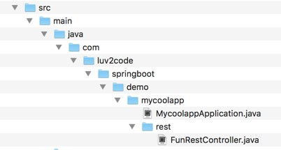

Java Source Code
Main Spring Boot application class
Created by Spring Initializr
RestController that we created in an earlier video

Slide 29


Java Source Code
File: MycoolappApplication.java
package com.luv2code.springboot.demo.mycoolapp;
import import
org.springframework.boot.SpringApplication; org.springframework.boot.autoconfigure.SpringBootApplication;
@SpringBootApplication
public class MycoolappApplication {
Enables
public static void main(String[] args)
{Auto configuration
SpringApplication.run(MycoolappApplication.class, args);
}
Component scanning
}
Additional configuration

Slide 30





Annotations
@SpringBootApplication is composed of the following annotations:
Annotation | Description
@EnableAutoConfiguration | Enables Spring Boot's auto-configuration support
@ComponentScan | Enables component scanning of current package Also recursively scans sub-packages
@Configuration | Able to register extra beans with @Bean or import other configuration classes

Slide 31


Annotations
@SpringBootApplication is composed of the following annotations:
Annotation | Description
@EnableAutoConfiguration | Enables Spring Boot's auto-configuration support
_{@ComponentScan} Enables component scanning of current package Also recursivSelaymsceaansnnsoubta-ptiaocnkasges that we've used before
_{@Configuration} Able to wreigthistterraedxittrioa nbaeal nSspwriinthg@aBpepans or import other configuration classes

Slide 32
Java Source Code
File: MycoolappApplication.java
package com.luv2code.springboot.demo.mycoolapp;
import import
org.springframework.boot.SpringApplication; org.springframework.boot.autoconfigure.SpringBootApplication;
@SpringBootApplication
public class MycoolappApplication {
public static void main(String[] args) {
SpringApplication.run(MycoolappApplication.class,
args);
}
}

Slide 33

Java Source Code
File: MycoolappApplication.java
package com.luv2code.springboot.demo.mycoolapp;
import import
org.springframework.boot.SpringApplication; org.springframework.boot.autoconfigure.SpringBootApplication;
@SpringBootApplication
public class MycoolappApplication {
public static void main(String[] args) {
SpringApplication.run(MycoolappApplication.class,
args);
}
}
Bootstrap your Spring Boot application

Slide 34

Java Source Code
File: MycoolappApplication.java
package com.luv2code.springboot.demo.mycoolapp;
import import
org.springframework.boot.SpringApplication; org.springframework.boot.autoconfigure.SpringBootApplication;
@SpringBootApplication
public class MycoolappApplication {
public static void main(String[] args) {
SpringApplication.run(MycoolappApplication.class,
args);
}
}
Bootstrap your Spring Boot application

Slide 35

Java Source Code
File: MycoolappApplication.java
package com.luv2code.springboot.demo.mycoolapp;
import import
org.springframework.boot.SpringApplication; org.springframework.boot.autoconfigure.SpringBootApplication;
@SpringBootApplication
public class MycoolappApplication {
public static void main(String[] args) {
SpringApplication.run(MycoolappApplication.class,
args);
}
}
Bootstrap your Spring Boot application

Slide 36



Java Source Code
Behind the scenes …
File: MycoolappApplication.java
package com.luv2code.springboot.demo.mycoolapp; _{Creates application context}
import import
org.springframework.boot.SpringApplication; and registers all beans
org.springframework.boot.autoconfigure.SpringBootApplication;
Starts the embedded server
@SpringBootApplication
public class MycoolappApplication {
Tomcat etc…
public static void main(String[] args) {
SpringApplication.run(MycoolappApplication.class,
args);
}
}
Bootstrap your Spring Boot application
www.luv2code.com

Slide 37

More on Component Scanning
Best Practice
Place your main application class in
the root package above your other packages
•
This implicitly defines a base search package
Allows you to leverage default component scanning
No need to explicitly reference the base package name

Slide 38

More on Component Scanning
Best Practice
Place your main application class in
the root package above your other packages
•
This implicitly defines a base search package
Allows you to leverage default component scanning
No need to explicitly reference the base package name
Common pitfall in traditional Spring apps
Anyone use the wrong package name before in traditional Spring apps???

Slide 39



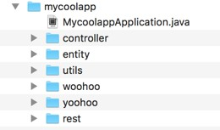
More on Component Scanning
Main Spring Boot application class
Automatically component scans sub-packages
Includes "rest" sub-package
Any other sub-packages you create Can give them any name

Slide 40


More on Component Scanning
Default scanning is fine if everything is under
com.luv2code.springboot.demo.mycoolapp
Explicitly list base packages to scan
•
But what about my other packages?
org.acme.iot.utils
edu.cmu.wean
package com.luv2code.springboot.demo.mycoolapp;
… @SpringBootApplication(
scanBasePackages={"com.luv2code.springboot.demo.mycoolapp",
"org.acme.iot.utils", "edu.cmu.wean"})
public class MycoolappApplication {
…
}

Slide 41

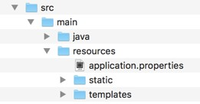

Application Properties
•
By default, Spring Boot will load properties from: application.properties
Created by Spring Initializr
Empty at the beginning
Can add Spring Boot properties
server.port=8585
Also add your own custom properties
coach.name=Mickey Mouse

Slide 42
Spring Boot Starters

Slide 43
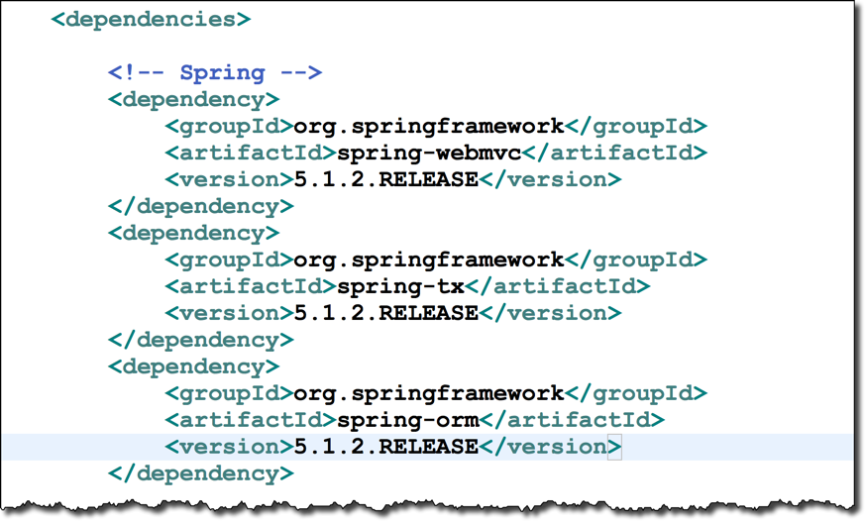
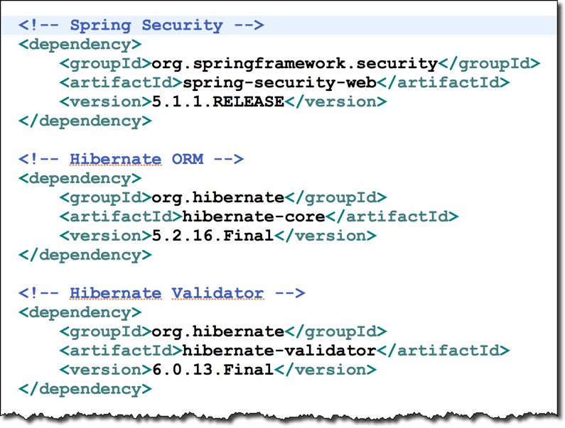




The Problem
Spring version
Which versions are compatible?

Slide 44

The Problem
Spring version
Which versions are compatible?
Very error-prone
Easy to make a simple mistake

Slide 45

Why Is It So Hard?
It would be great if there was a simple list of Maven dependencies
Collected as a group of dependencies … one-stop shop
So I don't have to search for each dependency
There should be an easier solution

Slide 46
The Solution - Spring Boot Starters
Spring Boot Starters
A curated list of Maven dependencies
A collection of dependencies grouped together
Tested and verified by the Spring Development team
Makes it much easier for the developer to get started with Spring
Reduces the amount of Maven configuration

Slide 47
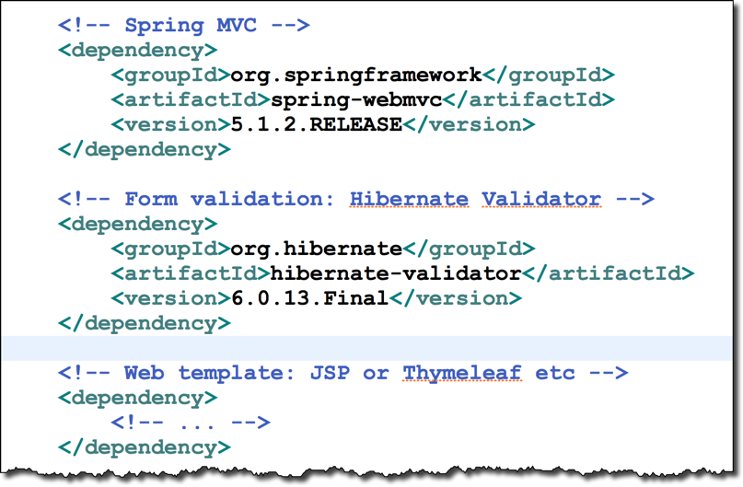
Spring MVC
For example, when building a Spring MVC app, you normally need

Slide 48

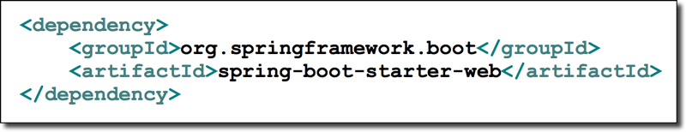


Solution: Spring Boot Starter - Web
Spring Boot provides: spring-boot-starter-web
Spring Boot Starters
A collection of Maven dependencies (Compatible versions)
CONTAINS
spring-web spring-webmvc
hibernate-validator
json tomcat
…
Save's the developer from having to list all of the individual dependencies
Also, makes sure you have compatible versions

Slide 49
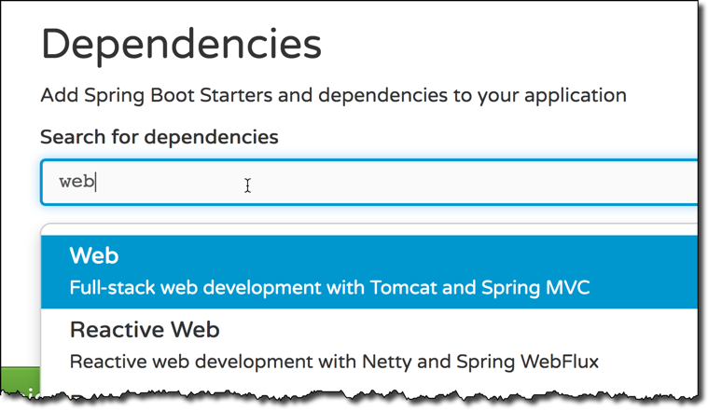
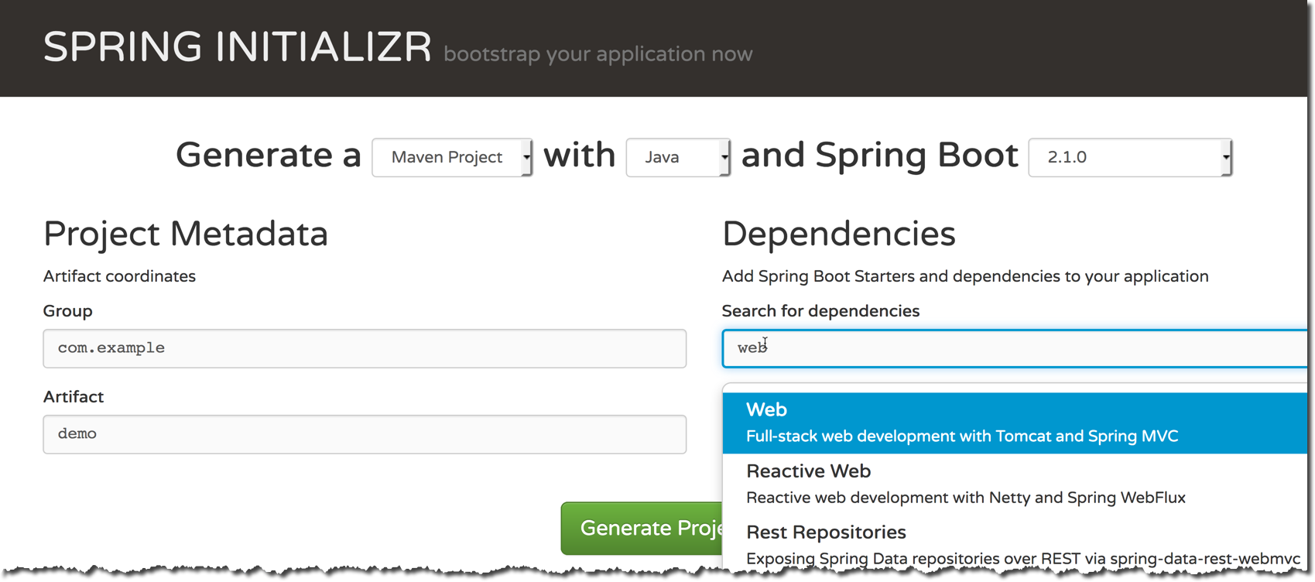
Spring Initializr
In Spring Initializr, simply select Web dependency
You automatically get spring-boot-starter-web in pom.xml

Slide 50

Spring Initializr
In Spring Initializr, simply select Web dependency
You automatically get spring-boot-starter-web in pom.xml

Slide 51
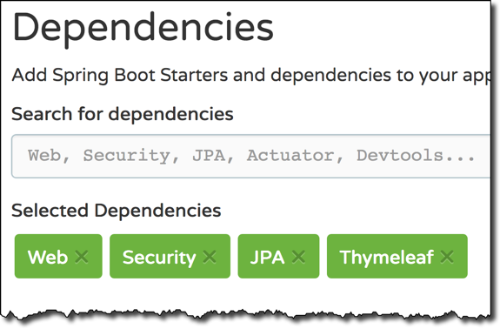



Spring Initializr
If we are building a Spring app that needs: Web, Security, …
Simply select the dependencies in the Spring Initializr
It will add the appropriate Spring Boot starters to your pom.xml
pom.xml

Slide 52
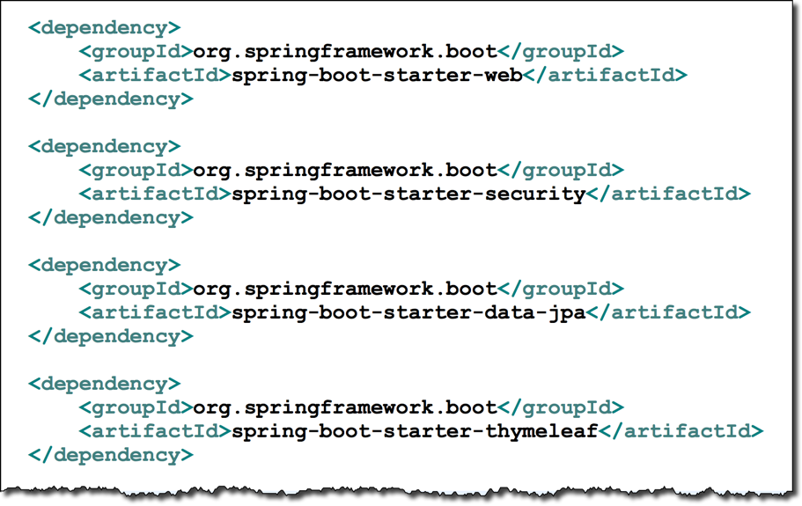


Spring Initializr
File: pom.xml

Slide 53

Spring Boot Starters
There are 30+ Spring Boot Starters from the Spring Development team
Name | Description
spring-boot-starter-web | Building web apps, includes validation, REST. Uses Tomcat as default embedded server
spring-boot-starter-security | Adding Spring Security support
spring-boot-starter-data-jpa | Spring database support with JPA and Hibernate
…

Slide 54
What Is In the Starter?
FAQ: What is in spring-boot-starter-xyz?
•
View the starter's POM file
•
Normally references other starters … so you will need to dig a bit
•
Somewhat cumbersome …

Slide 55
What Is In the Starter?
Most IDEs have a Dependency Management / View feature
Much easier to navigate
I'll show you how to do this with Eclipse and IntelliJ

Slide 56

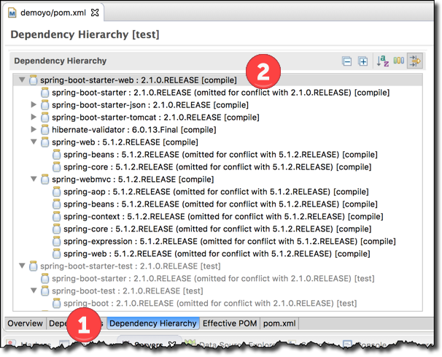
What Is In the Starter?
For Eclipse Users
Open the pom.xml
Select the tab Dependency Hierarchy
Expand the desired starter

Slide 57
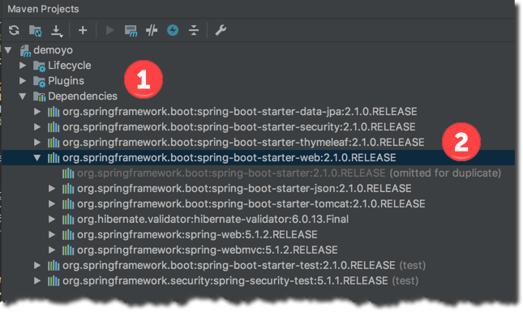

What Is In the Starter?
For IntelliJ users
Select View > Tool Windows > Maven Projects > Dependencies

Slide 58
Spring Boot Starter Parent

Slide 59
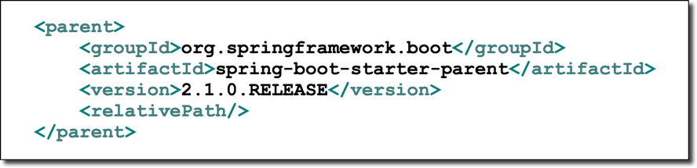

Spring Boot Starter Parent
Spring Boot provides a "Starter Parent"
This is a special starter that provides Maven defaults
Included in pom.xml when using
Spring Initializr

Slide 60
Spring Boot Starter Parent
Maven defaults defined in the Starter Parent
Default compiler level (currently Java 8)
UTF-8 source encoding
Others …

Slide 61
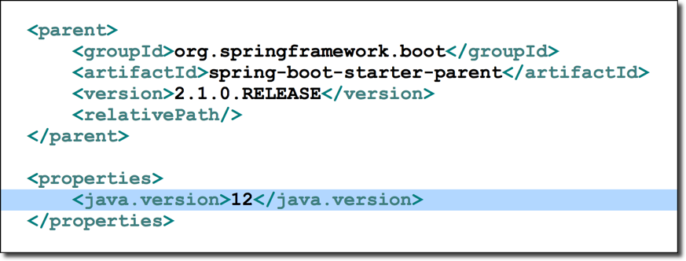
Spring Boot Starter Parent
To override a default, set as a property

Slide 62

Spring Boot Starter Parent
To override a default, set as a property
Specify your Java version

Slide 63
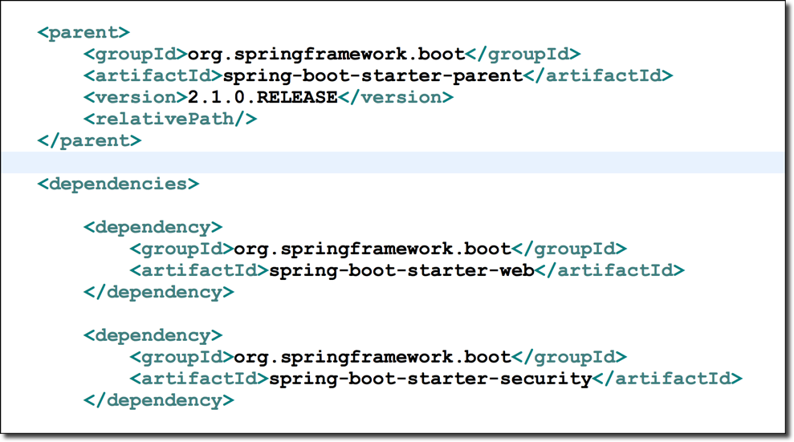
Spring Boot Starter Parent
For the spring-boot-starter-* dependencies, no need to list version

Slide 64

Spring Boot Starter Parent
For the spring-boot-starter-* dependencies, no need to list version
Specify version of Spring Boot

Slide 65

Spring Boot Starter Parent
For the spring-boot-starter-* dependencies, no need to list version
Specify version of Spring Boot
Inherit version from Starter Parent
www.luv2code.com

Slide 66

Spring Boot Starter Parent
For the spring-boot-starter-* dependencies, no need to list version
Specify version of Spring Boot
Inherit version from Starter Parent
No need to list individual versions Great for maintenance!

Slide 67

Spring Boot Starter Parent
Default configuration of Spring Boot plugin
<build>
<plugins>
<plugin>
<groupId>org.springframework.boot</groupId>
<artifactId>spring-boot-maven-plugin</artifactId>
</plugin>
</plugins>
</build>

Slide 68

Spring Boot Starter Parent
Default configuration of Spring Boot plugin
<build>
<plugins>
<plugin>
<groupId>org.springframework.boot</groupId>
<artifactId>spring-boot-maven-plugin</artifactId>
</plugin>
</plugins>
</build>
> mvn spring-boot:run

Slide 69
Benefits of the Spring Boot Starter Parent
Default Maven configuration: Java version, UTF-encoding etc
Dependency management
Use version on parent only
spring-boot-starter-* dependencies inherit version from parent
Default configuration of Spring Boot plugin

Slide 70
Spring Boot Dev Tools

Slide 71
The Problem
When running Spring Boot applications
If you make changes to your source code
Then you have to manually restart your application :-(

Slide 72
Solution: Spring Boot Dev Tools
spring-boot-devtools to the rescue!
Automatically restarts your application when code is updated
Simply add the dependency to your POM file
No need to write additional code :-)

Slide 73
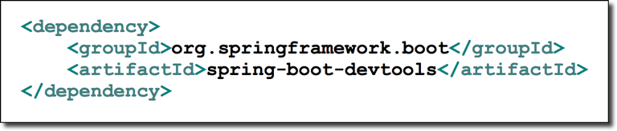

Spring Boot Dev Tools
Adding the dependency to your POM file
Automatically restarts your application when code is updated

Slide 74
Development Process
Step-By-Step
Edit pom.xml and add spring-boot-devtools
Add new REST endpoint to our app
Verify the app is automatically reloaded

Slide 75
Spring Boot Actuator

Slide 76
Problem
How can I monitor and manage my application?
How can I check the application health?
How can I access application metrics?

Slide 77
Solution: Spring Boot Actuator
Exposes endpoints to monitor and manage your application
You easily get DevOps functionality out-of-the-box
Simply add the dependency to your POM file
REST endpoints are automatically added to your application
No need to write additional code!
You get new REST endpoints for FREE!

Slide 78
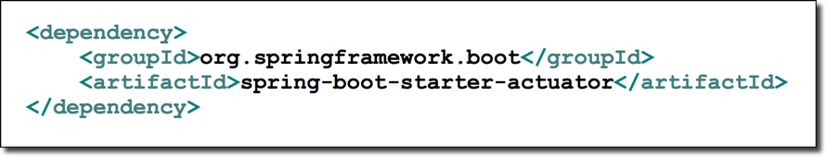
Spring Boot Actuator
Adding the dependency to your POM file

Slide 79




Spring Boot Actuator
Automatically exposes endpoints for metrics out-of-the-box
Endpoints are prefixed with: /actuator
Name | Description
/health | Health information about your application
/info | Information about your project
…

Slide 80
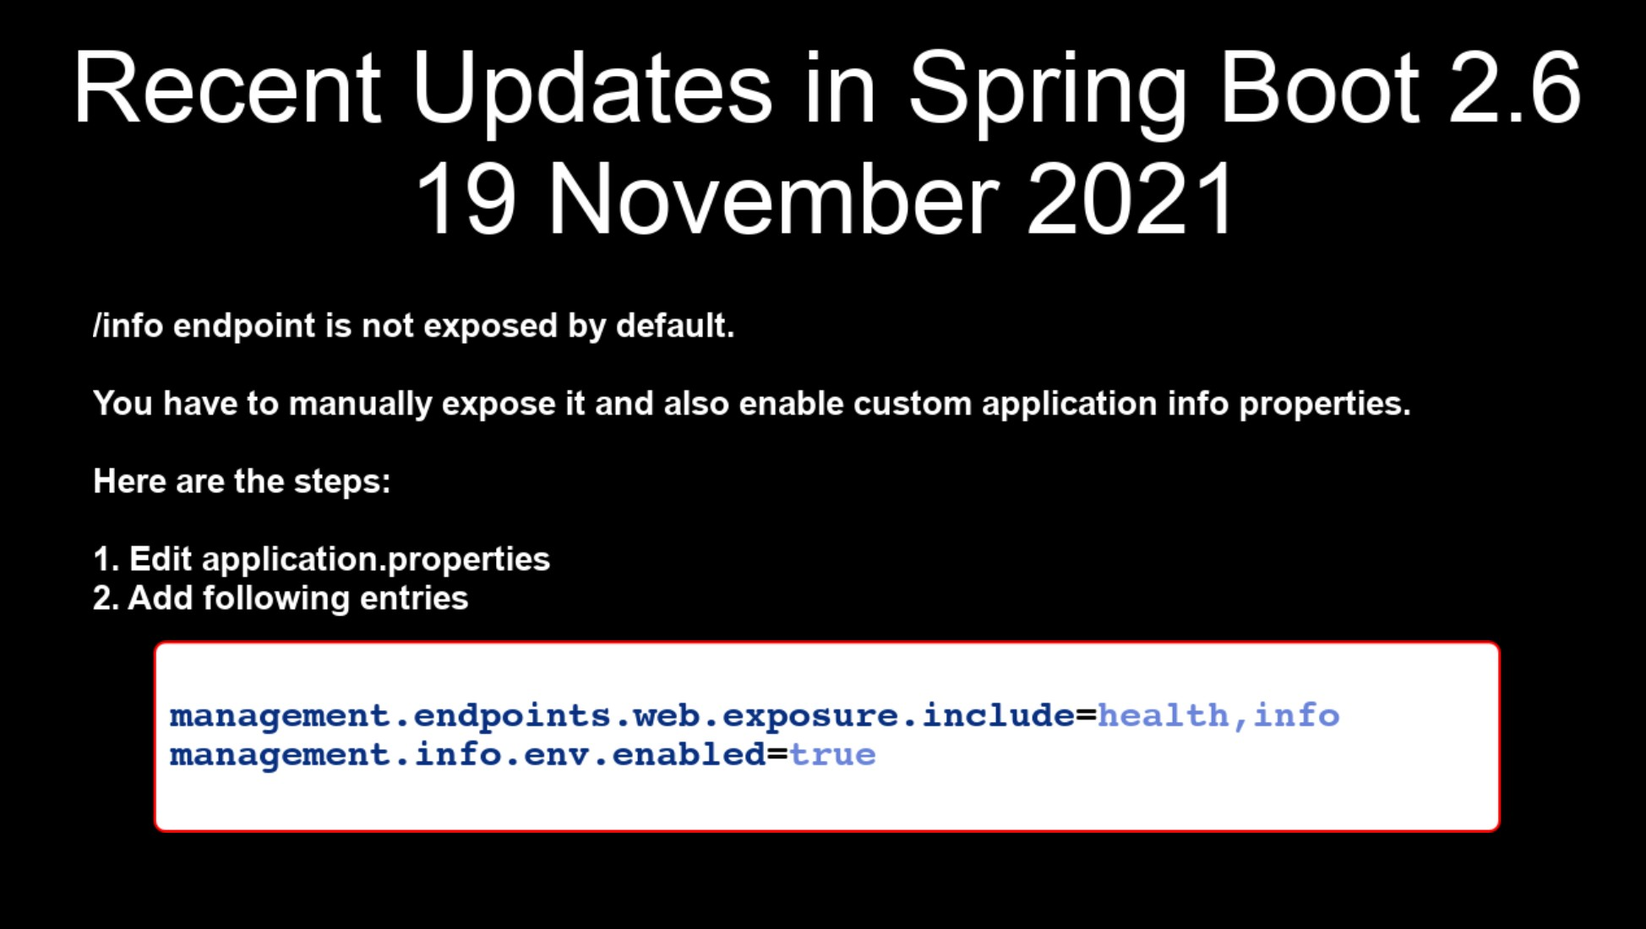

Slide 81
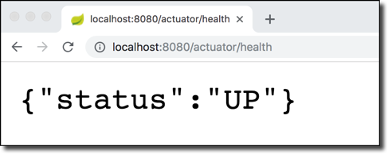
Health Endpoint
/health checks the status of your application
Normally used by monitoring apps to see if your app is up or down

Slide 82

Health Endpoint
/health checks the status of your application
Normally used by monitoring apps to see if your app is up or down
Health status is customizable based on
your own business logic

Slide 83
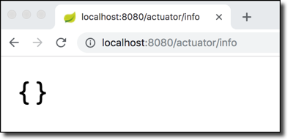
Info Endpoint
/info gives information about your application
Default is empty

Slide 84
Info Endpoint
Update application.properties with your app info

Slide 85

Info Endpoint
Update application.properties with your app info
File: src/main/resources/application.properties
info.app.name=My Super Cool App info.app.description=A crazy and fun app, yoohoo! info.app.version=1.0.0

Slide 86


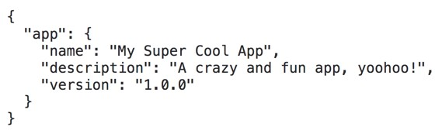
Info Endpoint
Update application.properties with your app info
File: src/main/resources/application.properties
info.app.name=My Super Cool App info.app.description=A crazy and fun app, yoohoo! info.app.version=1.0.0
www.luv2code.com

Slide 87





Spring Boot Actuator Endpoints
There are 10+ Spring Boot Actuator endpoints
Name | Description
/auditevents | Audit events for your application
/beans | List of all beans registered in the Spring application context
/mappings | List of all @RequestMapping paths
…

Slide 88


Exposing Endpoints
By default, only /health and /info are exposed
To expose all actuator endpoints over HTTP
File: src/main/resources/application.properties
# Use wildcard "*" to expose all endpoints
# Can also expose individual endpoints with a comma-delimited list #
management.endpoints.web.exposure.include=*

Slide 89
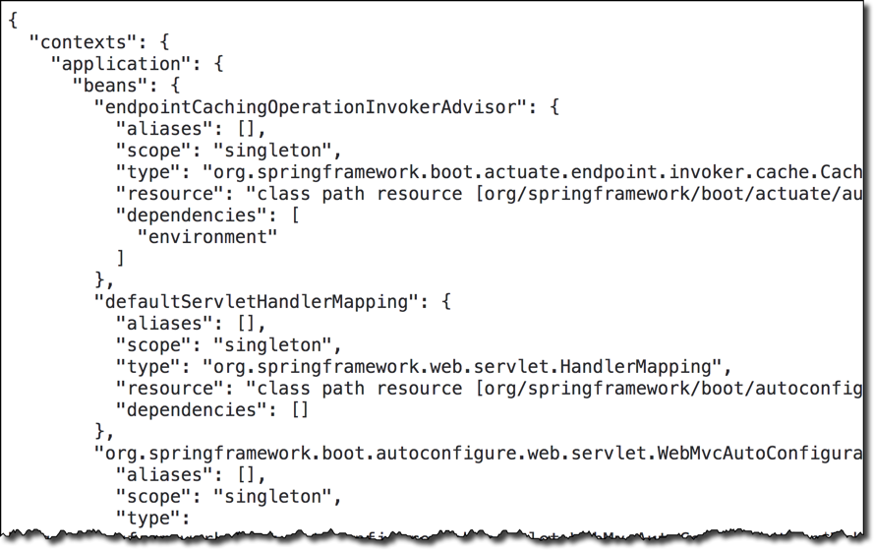
Get A List of Beans
Access http://localhost:8080/actuator/beans

Slide 90
Development Process
Step-By-Step
Edit pom.xml and add spring-boot-starter-acuator
View actuator endpoints for: /health and /info
Edit application.properties to customize /info

